Slide 1

Collinearity Diagnostics

Slide 2
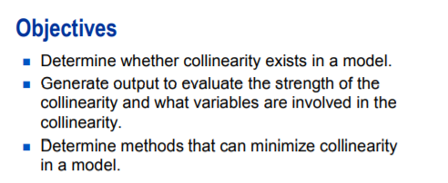
Collinearity Diagnostics

Slide 3
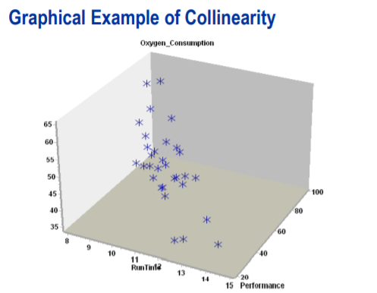
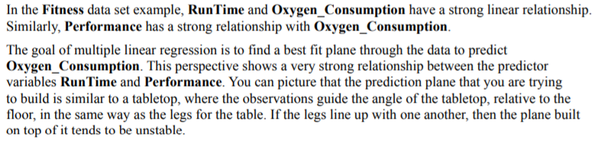
Collinearity Diagnostics

Slide 4
Collinearity Diagnostics
Why is this a problem? Two reasons exist.
Neither might appear to be significant when both are in the model. However, either might be significant when only one is in the model. Thus, collinearity can hide significant effects. (The reverse can be true as well. Collinearity can increase the apparent statistical significance of effects.
Collinearity tends to increases the variance of parameter estimates and consequently increase the prediction error. In the presence of collinearity, parameter estimates are not BLUE

Slide 5
Collinearity Diagnostics
When collinearity is a problem, the estimates of coefficients are unstable. This means that they have a large variance. Consequently, the true relationships between Y and Xs might quite different from that suggested by the magnitude and sign of the coefficients.
Collinearity is not a violation of assumption of linear regression.

Slide 6
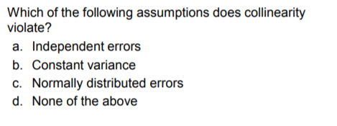
Collinearity Diagnostics

Slide 7
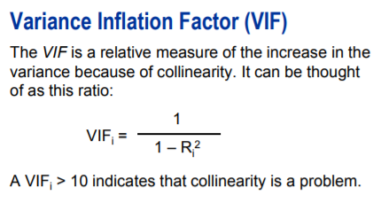
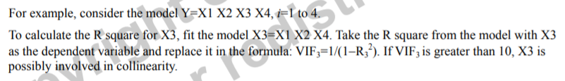
Collinearity Diagnostics
You can calculate VIF for each term in the model.
Marquardt (1990) suggests that VIF > 10 indicates the presence of strong collinearity in the model.

Slide 8
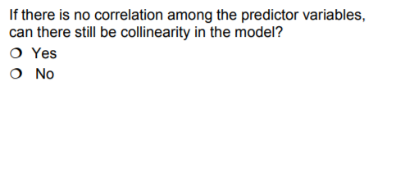
Collinearity Diagnostics

Slide 9

DEMO

Slide 10
Q&A

